Slide 1

Presenting
TUNEDIN
Trevor Hayward, Gina Muzi, Lizzy Fu, Kenny Davis

Slide 2

We are a bulletin board social media platform that allows for people to share and discuss music
COLLABORATIVE
INTERACTIVE
INFORMATIVE

Slide 3
Problem:
The inability to both share and discuss music effectively with friends in digital spaces, as well as create collaborative playlists regardless of what streaming platform people use
Solution:
A handy social media platform that allows for easy music sharing with friends, live listening sessions, and collaborative playlist building across numerous platforms
PROBLEM &
solution

Slide 4
DECONSTRUCTING TUNEDIN
Purpose
VALUES
Mission
Forge bonds through music.
Collaborative. Interactive. Informative.
Create a platform that builds community.
TunedIn is the only social media platform that unites a community of music enthusiasts.

Slide 5
Consumer Insights
Pain POints
FeedBack
Recommendations

Slide 6


Slide 7
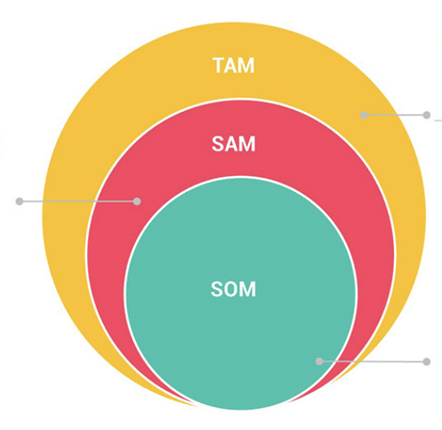
Total Addressable Market
SOM: College Students who are die hard fans of the same artist
SAM: Music Enthusiasts who have similar taste in music
TAM: Music Streaming Service Users

Slide 8









Competitive Landscape
Music-oriented
No Community
Discussion-based
Ubiquitous

Slide 9
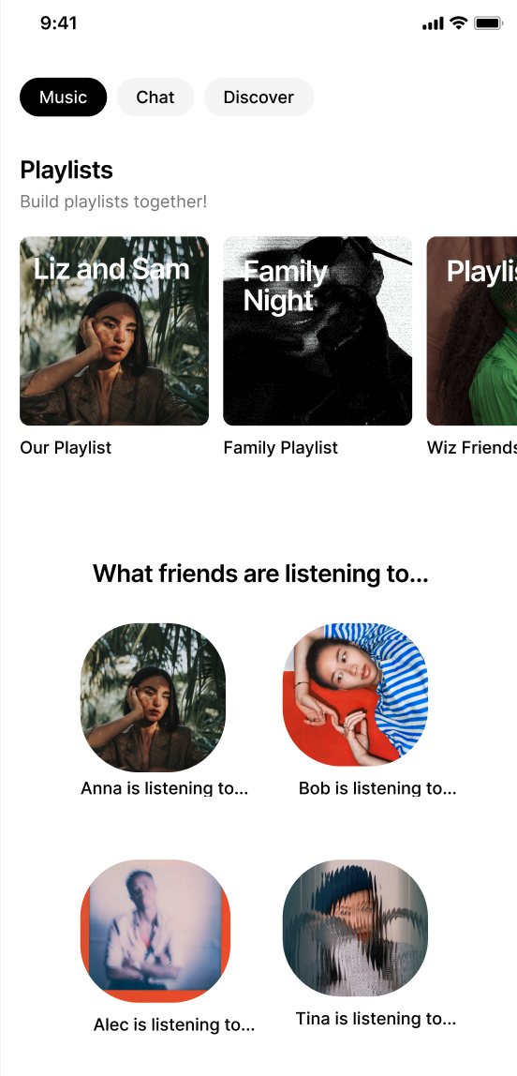
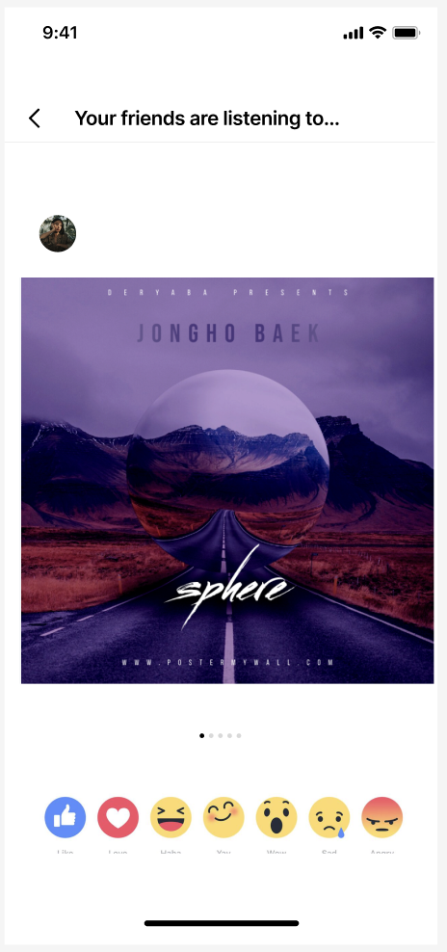
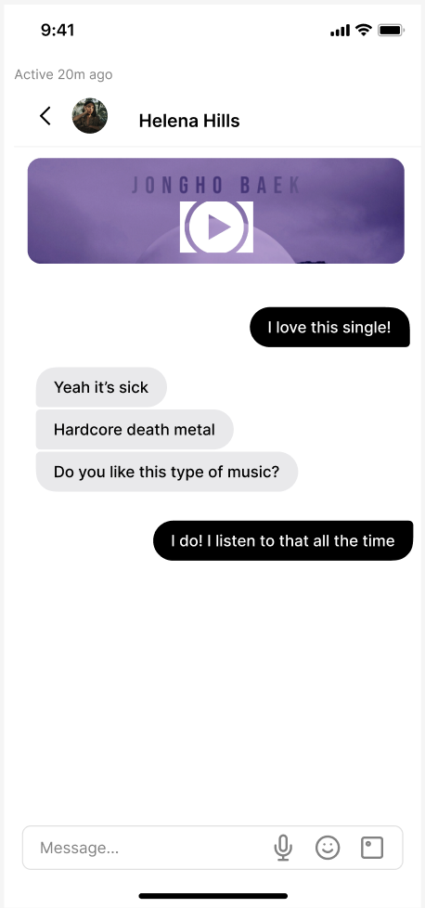
Key Features

Slide 10
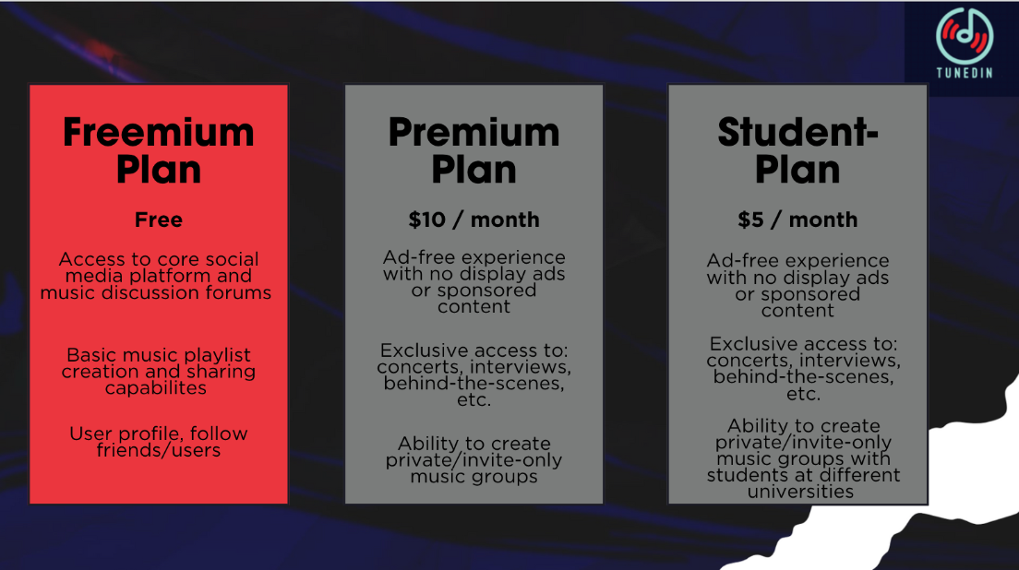
Notes:
Student Discount $5 - half off (same as apple music and spotify) - allow balanced competition with our competitors

Slide 11
Revenue model
Affiliate Marketing
Live Events or Experiences
Advertising
Paid Features/Virtual Goods
Sponsored Content/Brand Partnerships

Slide 12
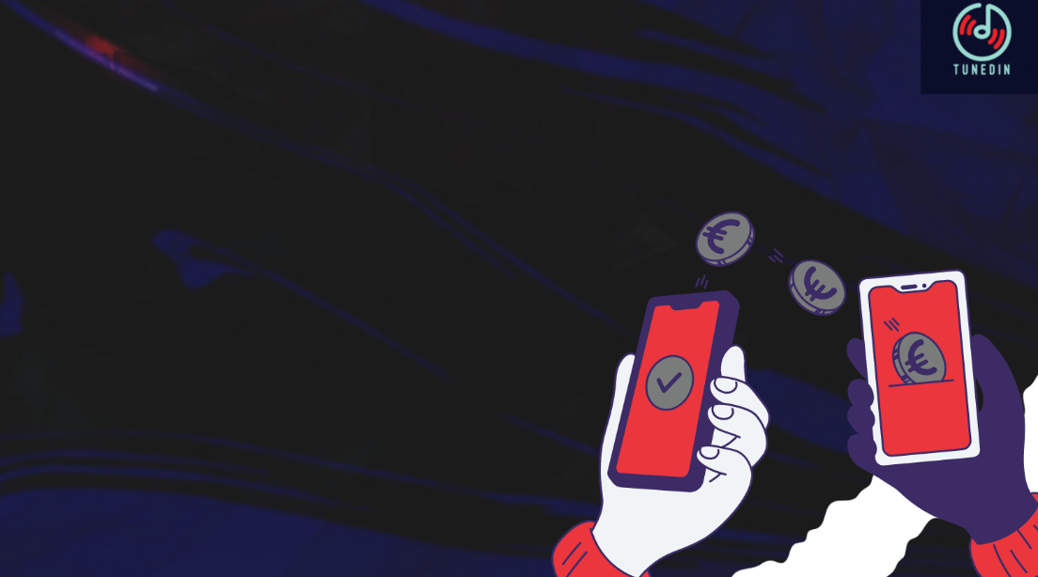
questions?

